Slide 1
Capstone Project: Grouping the world’s most populous Metropolitan cities
G.Mukkesh
June 1st, 2019

Slide 2
Introduction / Business Problem
With the advent of technology, the world has now become a global village. People living in different metropolitan cities of the world are being exposed to the cultures of various nations in the forms of movies, books, tv shows and restaurants, and are able to experience them without actually visiting the country.
The purpose of this study is to use the FourSquare location data to group different metropolitan cities into clusters, depending on how similar/dissimilar they are to each other. By doing so, we will be able to find out the cities which offer a similar lifestyle in terms of the amenities present.

Slide 3
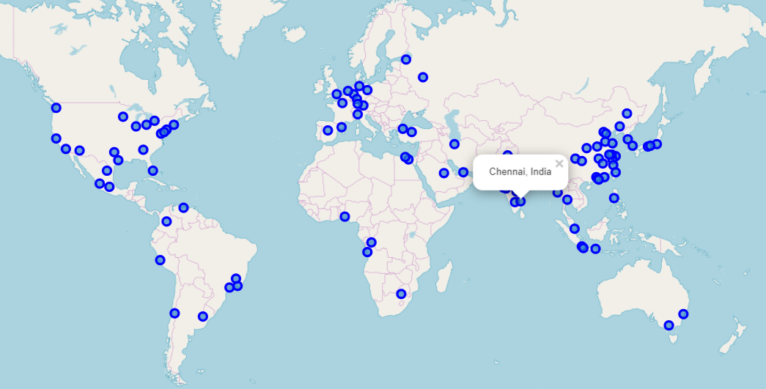
100 Most Populous Metropolitan Cities

Slide 4
Data
The 100 most populous metropolitan cities of the world were scraped from Wikipedia (https://en.wikipedia.org/wiki/List_of_metropolitan_areas_by_population).
Using the geocoder module in python, we get the latitudes and longitudes of the 100 cities need to be found.
Feeding these coordinates into the FourSquare API, we can get the top 100 venues for the cities, along with the venue’s longitudes, latitudes and venue category
After getting the top 10 locations for every city, we can get the set of unique venue categories and then one-hot-vector encode them, after grouping all the venues by their city to get the frequency of occurrence .

Slide 5
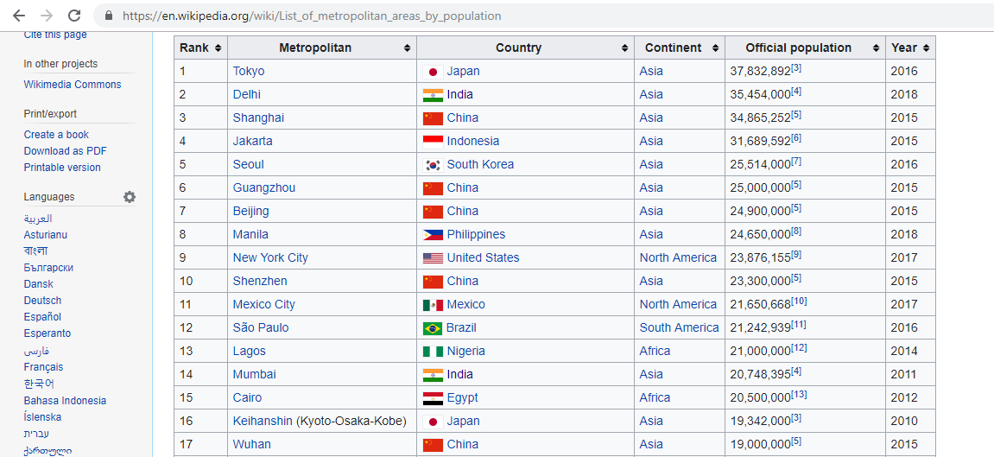
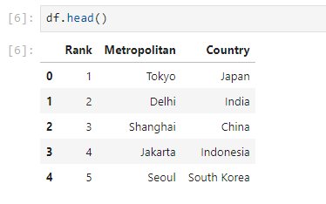
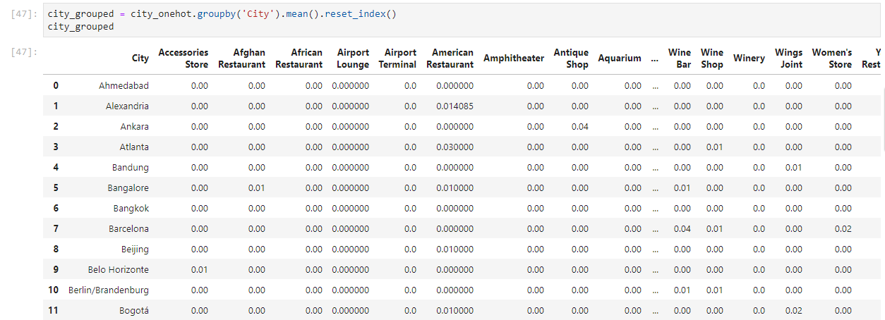
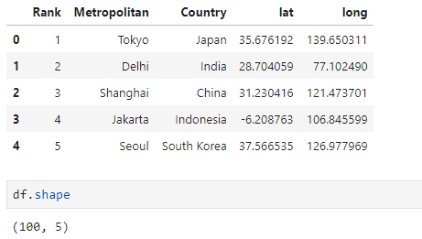

Slide 6
Methodology
Web scraping was carried out using Python’s beautifulsoup package to gather the list of top 100 most populous metropolitan cities in the world
The GeoCoder package was used to get the co-ordinates of the scraped cities.
Foursquare API was used to get additional information needed for the analysis. Data wrangling was performed to clean and transform the data, and it was loaded into a pandas frame.
Folium package was used to visualize the locations on a map.
K-Means++ Clustering Algorithm was applied on the data set to cluster the cities and inferences were made from it.

Slide 7
K-Means ++ Algorithm
K-Means++ algorithm is a variation of the unsupervised K-Means algorithm which doesn’t use the Random Initialization of cluster centroids. Instead, an optimised approach for initialising the clustered centroids is followed.
Even though initialization taken extra time, the k-means part itself converges very quickly after this seeding and thus the algorithm actually lowers the computation time and decreases the error rate. The elbow-curve method is used to determine the optimal number of clusters.
After Initialization, the algorithm is the same as that of k-means i.e., iteratively tries to minimise the intra-cluster variance and maximise the inter-cluster variance by re-calculating the least squared Euclidean distances and reassigning cluster centroids till they don’t get re-assigned anymore.

Slide 8
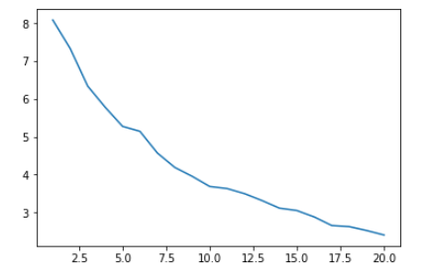
K-Means++ Elbow Graph
Using the K-Means++ Elbow chart, which plots within group variance vs the number of clusters, we can see that a sharp bend arises for n=5 and n=10.
We have chosen n=10 for this analysis.

Slide 9
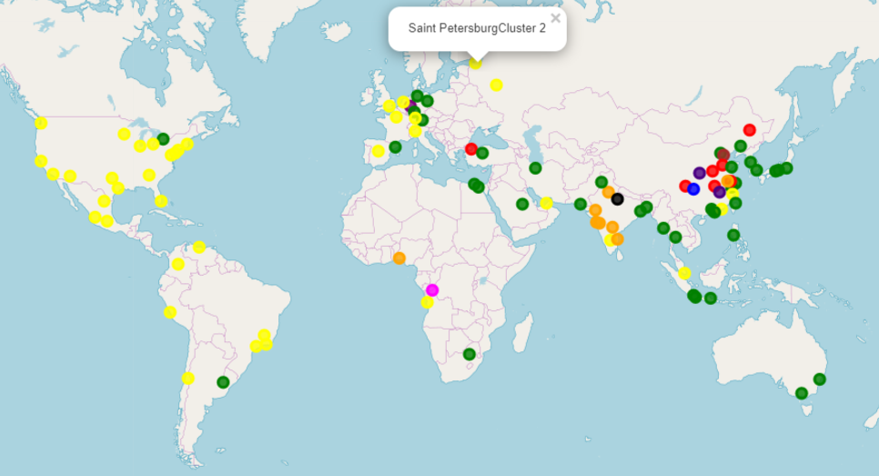
Results
10 clusters were created and the cities were assigned to them accordingly.
Even though the clusters had some cities in them which made it look erroneous , further exploration proved that the clusters were, indeed consistent with their results.
Due to this, hidden connections between different cities of the world were unearthed.

Slide 10
Additional Results (Exploration)
From the results, we can observe that most of the European cities and American (north and south) are very similar to each other. Similarly, most of the Arabian cities and south-east/east Asian, Australian and a few European cities are similar. These countries have Asians in their population, who have become permanent residents of the country over time.
Most of the Indian cities fall under a cluster, whose features are also interestingly shared by Nanjing in China and Lagos in Nigeria. Further exploration found out that many Indian students study in Nanjing, and the local lifestyle is a bit similar to the cities here. Nigeria has over 217,000 Indians currently, and has over 8000 permanently settled Indians. Hinduism, the major religion of India, is a major religion in Nigeria too.
Interestingly, Bangalore, the Silicon Valley of India, falls under the same cluster as all the American cities (including San Francisco, the Silicon Valley of America).
Istanbul falls under the same cluster as many Chinese cities. Further exploration found out that Istanbul has a significantly large Chinese community.

Slide 11
Conclusion
The K-Means ++ algorithm was used to cluster these cities depending on how similar they were to one another.
By analysing the cities present in the different clusters, I was able to find out probable reasons to why they might fall under the same cluster, even though it seemingly looked as if they no connections to each other in the first place.
Using these observations, one can find out whether the new city that he/she is moving to has a lifestyle which is similar or dissimilar to the one that he/she is currently residing in.

